Slide 1


Microsoft Power BI Module 6 – Power BI Service

Slide 2
Agenda
Introduction to Power Bl Service
Dashboards
Designing Dashboards
Comparing Power Bl Desktop with Service
Features in Creating Dashboards
Reports vs Dashboards
Power Bl Q &A
Row-level Security
Paginated Reports
Quick Insights in Power Bl
Sharing Reports and Dashboards
Introduction to Report Server

Slide 3
Introduction to Power Bl Service

Slide 4
Introduction to Power Bl Service
Power Bl Service, also referred to as Power Bl Online, is a Software-as-a-Service (SaaS) part of Power BI.
Power BI Service is a web portal for publishing reports, building dashboards, and sharing
with other employees in an organization.

Slide 5




Introduction to Power Bl Service
Dashboards
Dashboards are treated by pinning visuals from reports. such bar charts, pie charts. etc.
Report
It is a mufti-perspective view into a dataset. with visuals that represent different key insights from that dataset. It Can have single visual or have pages full Of visual
Workbooks
We can directly import Workbooks into the power Service workspace to access the data and the reports
When we publish a report. datasets used in the report Will be displayed under the Datasets section alphabetically.
Datasets
When we sign in to the Power BI Service portal, we will get a personal space called My Workspace, and this
workspace consists of the following areas:

Slide 6
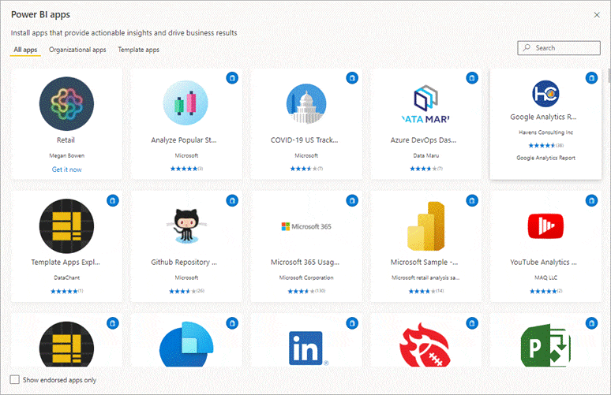
Introduction to Power Bl Service
The Power Bl Service portal also has an App Workspace, which enables us to share dashboards and
reports with our colleagues.
We, first, add our reports and dashboards to the app and then share
the app with the others in our organization.

Slide 7
Comparing Power Bl Desktop with Power Bl Service

Slide 8
Comparing Power Bl Desktop with Power Bl Service
Power BI Desktop
Many data sources
Transforming
Modelling
Measuring
Calculated Columns
RLS creation
Filters
Both
Reports
Visualizations
Security
Bookmarks
R visuals
Power BI Service
Some data sources
Dashboards
Apps and workspaces
Sharing
Paginated reports
RLS management
Gateway connections

Slide 9
Dashboards

Slide 10
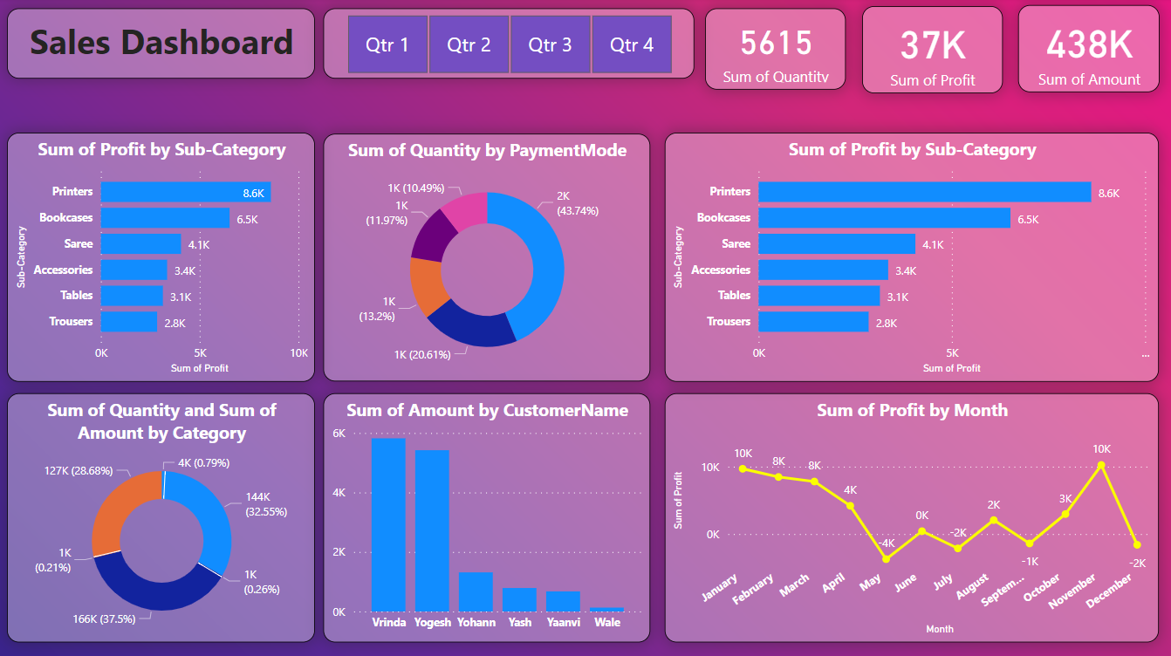
Dashboards
A Power Bl dashboard is a single page, known as a canvas, that uses the most important
element in a report to tell a story

Slide 11
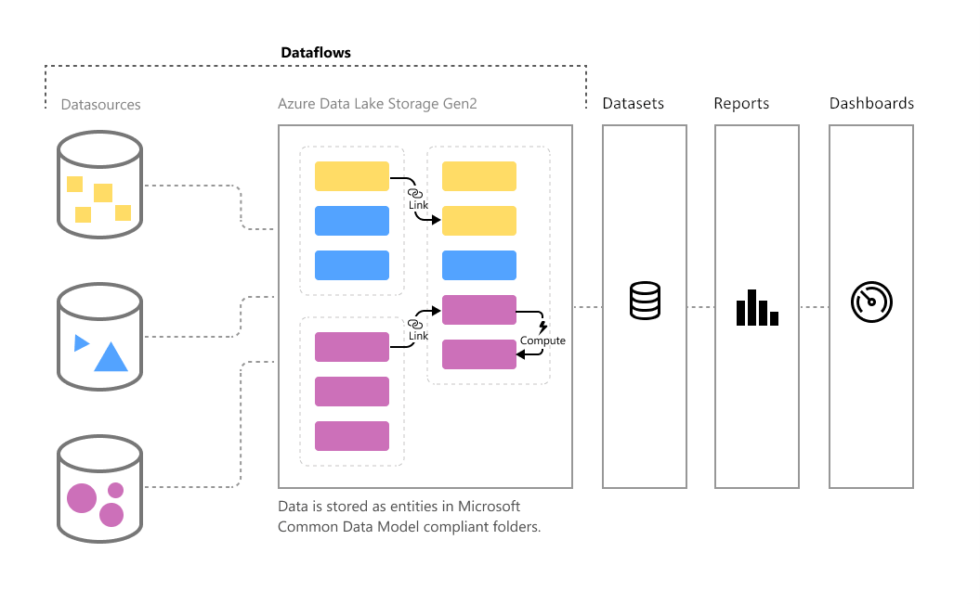
Dashboards
Visualizations used in a dashboard are known as tiles and are pinned to the dashboard by
report designers

Slide 12
Features in Creating Dashboards

Slide 13
Features in Creating Dashboards
Pin a Live Page
We can pin a complete report page toa dashboard as a single tile item
Pin from Dashboard
We can pin a tile taken from one dashboard into another dashboard

Slide 14
Features in Creating Dashboards
Dashboard Sharing
We can share or unshare dashboards with other users, and these dashboards will be read-only for the recipients of the shared invitation
Focus Mode
Toget a greater detail of the dashboard, we can use the focus mode. This works equally with all the visuals in the dashboard

Slide 15
Features in Creating Dashboards
Fullscreen Mode
Power BI dashboards can be displayed in full screen, which is ideal for presentations and TV screens
Last Refresh
Items used in a dashboard can display the last updated date and time, which ensures that all the users have the most up-to-date figures

Slide 16
Features in Creating Dashboards
Favourite Dashboard
We can make a dashboard 'favorite', so we can access it anywhere from Power Bl Service
Featured Dashboard
A featured dashboard is also like a favourite dashboard but is given the status of being the first dashboard as soon as we login

Slide 17
Designing Dashboards

Slide 18
Designing Dashboards
Customizing Visuals
Use colors, layers, and borders to enhance and group related visuals
Positioning
Most important information shouldbe placed on the top Of the dashboard
Focusing on Audience
Design dashboards focusing on the end user
Use bigger visuals for showing the most important data
Storytelling
Place only the relevant and related data in the dashboard
Formatting Visuals

Slide 19
Demo: Creating a Dashboard

Slide 20
Dashboards vs Reports

Slide 21
Dashboards vs Reports
Capability
Pages
Data Sources
Filtering
Drilling down in Visuals
Available in Power BI desktop
Dashboards
One page
One or more datasets
Cannot be filtered or slice. In focus mode, filtering can be done a dashboard tile, but you can't save the filter.
No
Yes
Reports
Single dataset
Yes
Yes
Yes
Yes
Only if an entire report page is pinned to a dashboard.
One or more pages
Q & A

Slide 22
Power Bl Q & A

Slide 23
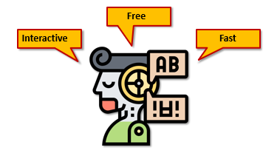
Power Bl Q & A
Power BI Q&A helps us ask questions about our data using natural language query.
Power BI Q&A also helps us phrase our question, provides
auto-complete, restates question, and corrects spelling

Slide 24
Power Bl Q & A
Q&A supports wide range of questions, including but not limited to the
following:
Return the Top N
Sort Results
Compare Data
Provide a Filter
View Trends
Use Complex Aggregations

Slide 25
Power Bl Q & A
Limitations of Power Bl Q&A are the following:
Data Sources
Power does not support object- level security with any type of data.
Review Questions
Review questions show questions against our data model only for up to 28 days.
Teach Q & A
It allows us to teach the words it has not recognized yet but supports only the import mode.
Multiple Conditions
Multiple conditions on a single Q&A are not supported.

Slide 26
Demo: Q&A on Dashboards

Slide 27
Quick Insights in Power BI

Slide 28
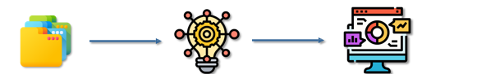
Quick Insights in Power BI
The Quick Insights option helps us create dashboards quickly and explore insights that we might have missed.
Here, the visualizations are produced in a special canvas that has up to 32 insight cards with a small description of each.
Quick Insights does not work with DirectQuery; it only works with the data uploaded into Power Bl.
Datasets
Quick Insights
Visualizations

Slide 29
Quick Insights in Power BI
To optimize our data for Power Bl Quick Insights, we have to follow the below:
Hide the unnecessary columns and unhide interesting ones.
Use a mix Of data types such as names, numbers, time, etc.
Avoid columns with duplicate information that wastes our valuable time, which can be used for searching meaningful patterns.
If our data model is simple or doesn't have much data, then we might get an error, so we must usestatistically significant data.

Slide 30
Row-level Security

Slide 31
Row-level Security
Row-level security (RLS) in Power Bl can be used to restrict data access for the specified users.
Filters are defined within the roles that restrict the data access at the row level.
Define roles and rules in Power Bl Desktop
Validate the roles in Power Bl Desktop
Add/Remove members to/from the role in Power Bl Service
Validate the role in Power Bl Service

Slide 32
Row-level Security
Limitations of row-level security:
02. Roles created in Power Bl Service have to be recreated in Power Bl Desktop
03. Cortana and Q&A do not support row-level security
04. Only imported data and direct query connections are supported
05. RLS supports datasets created on Power BI Desktop. It is in Excel, we need to convert it into a .pbix file
01. To use RLS, we need a Power Bl Pro subscription

Slide 33
Demo: Row-level Security

Slide 34
Sharing Reports and Dashboards

Slide 35
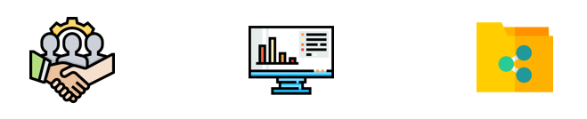
Sharing Reports and Dashboards
These are some of the ways to share reports and dashboards in Power 81:
Collaborate
Share Reports and Dashboards
Share Data

Slide 36
Sharing Reports and Dashboards
When teams work together, they need access to the same documents so that they can collaborate easily.
Collaborate in workspace
Collaborate in Microsoft Teams
Collaborate

Slide 37
Sharing Reports and Dashboards
We can share Power Bl reports and dashboards with others to access the content, but we need a Power BI Pro license to
share our content.
Annotate and share from Power Bl mobile app
Distribute insights from the app.
Embed in secure portals.
Publish to public sites Print.
or save as PDF
Sharing Reports and Dashboards

Slide 38
Sharing Reports and Dashboards
When you create a report with a data model that everyone should use, you can save that report to the Power Bl service. Then they can
build their reports on your dataset.share our content.
Share datasets
Create dataflows
Share Data

Slide 39
Paginated Reports

Slide 40
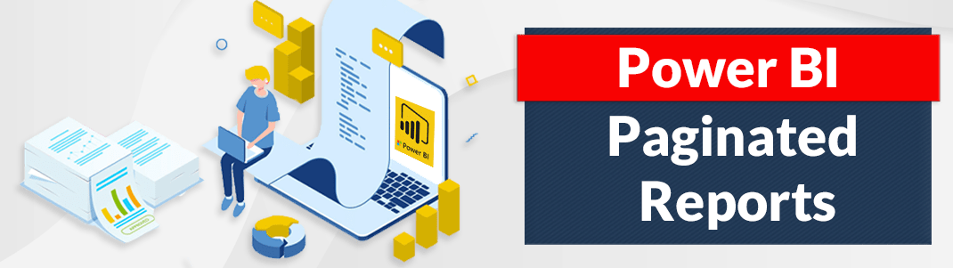
Paginated Reports
Paginated reports are formatted to fit well on a page and are designed to be printed or shared.
Paginated reports are also called pixel perfect because we can control the layout of the report page exactly.
Power Bl Report Builder is the standalone tool for authoring paginated reports for Power Bl service

Slide 41
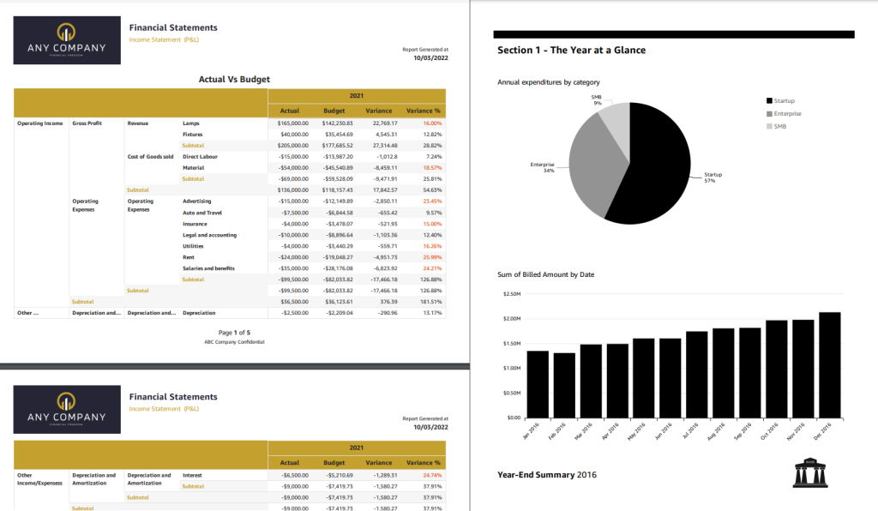
Paginated Reports

Slide 42
Introduction to Report Server

Slide 43
Introduction to Report Server
Power Bl Report Server is the on-premises location for publishing our reports, creating dashboards and apps, and sharing data with others in our organization.
There are two ways to purchase Power Bl Report Server.
Purchasing Power Bl Premium
Purchasing SQL Server Enterprise Edition
Ways

Slide 44
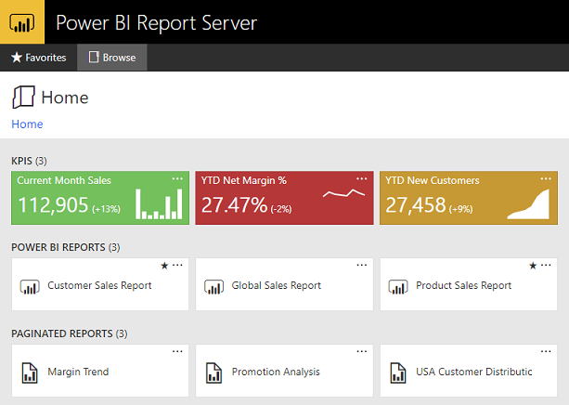
Introduction to Report Server
The entry to Power Bl Report Server is a secure web portal, which can be viewed in any of the modern browsers.
The content of a web browser is organized in a traditional folder hierarchy: Power Bl Reports, Mobile Reports, Paginated Reports, KPIs, and Excel Workbooks.
We can find the shared datasets and data sources in their respective folders.

Slide 45
Introduction to Report Server
Power Bl Report Server and Power Bl Service have many similarities and some key differences too
Features
Deployment
Real-time Streaming
Dashboards
Quick Insights
Paginated Reports
Power BI Report Server
Hosted on-premises or on the cloud
Power Bl Service
Hosted on the cloud
Q&A
No
No
No
No
Yes
Yes
Yes
Yes
Yes
Yes

